Slide 1
Primes, GCD, LCM and Euclidian Algorithm

Slide 2
Section Summary
Prime Numbers and their Properties
Conjectures and Open Problems About Primes
Greatest Common Divisors (GCD)
Least Common Multiples (LCM)
The Euclidian Algorithm
The Extended Euclidian Algorithm

Slide 3
Primes
Definition: a positive integer p greater than 1 is called prime if the only positive factors of p are 1 and p. A positive integer that is greater than 1 and is not prime is called composite.
Example: 7 is prime because its only positive factors are 1 and 7, but 9 is composite because it is divisible by 1, 9, and also 3.
Theorem: every positive integer greater than 1 can be written uniquely as a prime or as the product of primes.
Examples:
100 = 2 × 2 × 5 × 5 = 2² × 5²
64 = 2 × 2 × 2 × 2 × 2 × 2 = 2⁶

Slide 4
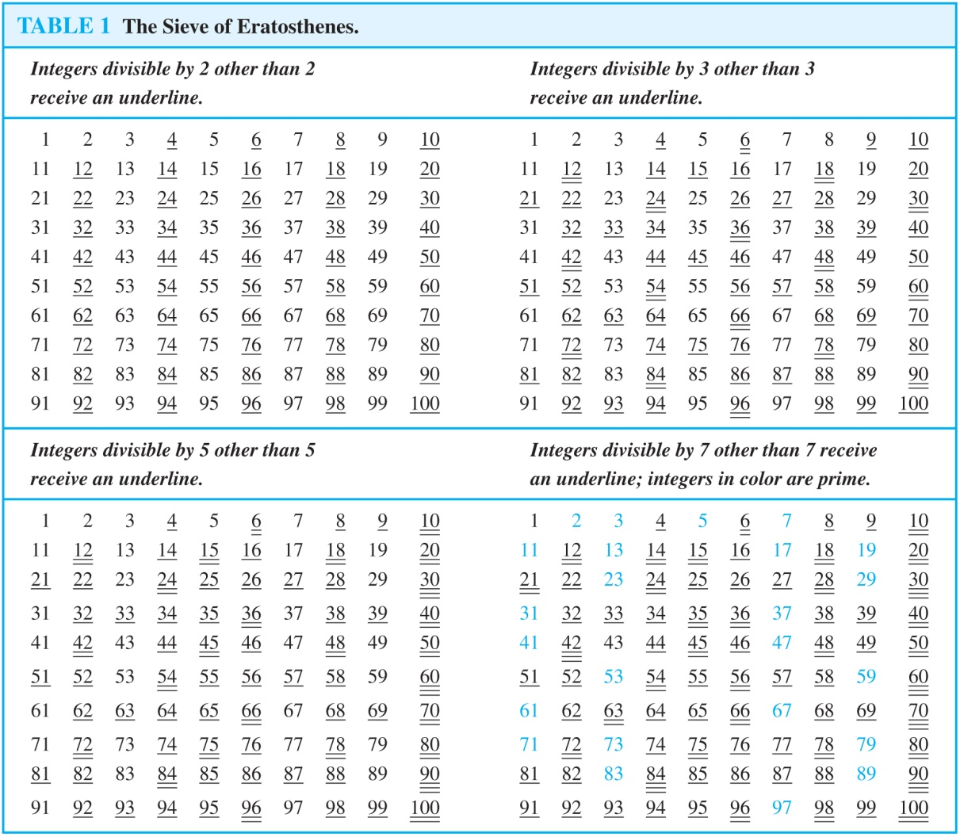
Determining Prime Numbers
If an integer n is a composite integer, then it has a prime divisor less than or equal to √n.
Trial division: a very inefficient method of determining if a number n is prime, is to try every integer i ≤√n and see if n is divisible by i.

Slide 5
Mersenne Primes
Definition: prime numbers of the form 2^{p} − 1 , where p is prime, are called Mersenne primes.
Such as 2² − 1 = 3, 2³ − 1 = 7, 2⁵ − 1 = 31 , and 2⁷ − 1 = 127.
2¹¹ − 1 = 2047 is not a Mersenne prime since 2047 = 23×89 is not a prim number.
As of mid 2011, 47 Mersenne primes were known, the largest is 2^{43,112,609} − 1, which has nearly 13 million decimal digits.
The Great Internet Mersenne Prime Search (GIMPS) is a distributed computing project to search for new Mersenne Primes: http://www.mersenne.org/

Slide 6
Generating Primes
The problem of generating large primes is of both theoretical and practical interest. We later see that finding large primes with hundreds of digits is important in cryptography.
So far, no useful closed formula that always produces prime numbers has been found:
But f (n) = n² − n + 41 is prime for all integers 1, 2, …, 40. But f (41) = 41² is not a prime number.
More generally, there is no polynomial with integer coefficients such that f (n) is prime for all positive integers n.
Fortunately, we can generate large integers which are almost certainly primes. We will see this later on.

Slide 7
Conjectures about Primes
Goldbach’s Conjecture: every even integer n > 2, is the sum of two primes, e.g., 8 = 3+5, 12 = 5+7, etc.
It has been verified by computer for positive even integers up to 1.6 × 10¹⁸. It is believed to be true by most mathematicians.
The Twin Prime Conjecture: there are infinitely many pairs of twin primes where “twin primes” are pairs of primes that differ by 2, e.g., 3 and 5, 5 and 7, 11 and 13, etc.
The current world’s record for twin primes consists of numbers 65,516,468,355 × 23^{33,333} -1 and 65,516,468,355 × 23^{33,333} +1, which have 100,355 decimal digits.

Slide 8
Greatest Common Divisor
Definition: let a and b be integers, not both zero. The largest integer d such that d | a and also d | b is called the greatest common divisor of a and b, denoted by gcd(a,b).
Example: what is the greatest common divisor of 24 and 36?
Solution:
24 = 2³ × 3 and 36 = 2² × 3² therefore gcd(24,36) = 12
Example: what is the greatest common divisor of 17 and 22?
Solution:
17 = 1 × 17 and 22 = 2 × 11 therefore gcd(17,22) = 1
In fact, 17 and 22 are relatively prime.

Slide 9
Greatest Common Divisor
Definition: the integers a and b are relatively prime if their greatest common divisor is 1, e.g., 17 and 22.
Definition: the integers a₁, …, a_{n} are pairwise relatively prime if gcd(a_{i}, a_{j})= 1 whenever 1 ≤ i < j ≤n.
Example: determine if 10, 17 and 21 are pairwise relatively prime.
Solution: because gcd(10,17) = 1, gcd(10,21) = 1, and gcd(17,21) = 1. Therefore, 10, 17, and 21 are pairwise relatively prime.
Example: determine if 10, 19, and 24 are pairwise relatively prime.
Solution: because gcd(10,24) = 2, therefore, 10, 19, and 24 are not pairwise relatively prime.

Slide 10
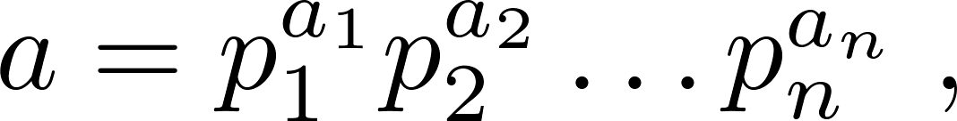
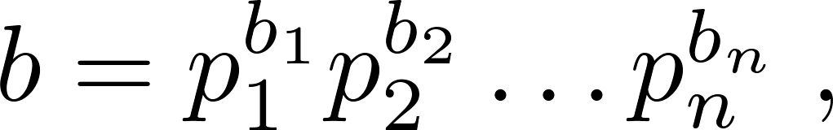
Finding GCD Using Prime Factorizations
Suppose the prime factorizations of a and b are:
where each exponent is a nonnegative integer, and where all primes occurring in either prime factorization are included in both. Then:
Example: 120 = 2³ × 3 × 5 500 = 2² × 5³
gcd(120,500) = 2^{min(3,2)} × 3^{min(1,0)} × 5^{min(1,3)} = 2² × 3⁰ × 5¹ = 20
Finding the gcd of two positive integers using prime factorizations is not efficient because there is no efficient algorithm for finding the prime factorization of a positive integer.

Slide 11
Least Common Multiple
Definition: the least common multiple of the positive integers a and b is the smallest positive integer that is divisible by both a and b. It is denoted by lcm(a,b).
The lcm can also be computed from the prime factorizations.
Example: lcm(2³3⁵7², 2⁴3³) = 2^{max(3,4)} 3^{max(5,3)} 7^{max(2,0)} = 2⁴ 3⁵ 7²
The greatest common divisor and the least common multiple of two integers are related by the following theorem:
Theorem: let a and b be positive integers. Then
ab = gcd(a,b) × lcm(a,b)

Slide 12
Euclidean Algorithm
The Euclidian algorithm is an efficient method for computing the greatest common divisor gcd of two integers.
Example: find gcd(91,287).
287 = 91 × 3 + 14
91 = 14 × 6 + 7
14 = 7 × 2 + 0
gcd(287,91) = gcd(91,14) = gcd(14,7) = 7

Slide 13
Euclidean Algorithm
The Euclidean algorithm expressed in pseudocode is:
We later see that the time complexity of the algorithm is O(log b), where a > b.
procedure gcd(a, b: positive integers)
x := a
x := b
while y ≠ 0
r := x mod y
x := y
y := r
return x

Slide 14
gcds as Linear Combinations
Theorem: if a and b are positive integers, then there exist integers s and t such that gcd(a,b) = sa + tb. This is a linear combination with integer coefficients of a and b.
252 = 198 × 1 + 54
198 = 54 × 3 + 36
54 = 36 × 1 + 18
36 = 18 × 2 + 0
Now working backwards
18 = 54 - 1 × 36
36 = 198 - 3 × 54
54 = 252 - 1 × 198
Substituting the 2nd equation into the 1st equation yields:
18 = 54 - (1 × (198 - 3 × 54)) = -1 × 198 + 4 × 54
Substituting 3rd equation into the above equation yields:
18 = -1 × 198 + (4 × (252 - 1 × 198)) = 4 × 252 - 5 × 198 (extended Euclidean algorithm)

Slide 15
Dividing Congruences by an Integer
Dividing both sides of a valid congruence by an integer does not always produce a valid congruence (see Lec02 slide 7).
But dividing by an integer relatively prime to the modulus does produce a valid congruence:
Theorem: let m be a positive integer and let a, b, c be integers. If ac ≡ bc (mod m) and gcd(c,m) = 1, then a ≡ b (mod m).
Example: 36 ≡ 22 (mod 7)
Since gcd(2,7) = 1, therefore, 18 ≡ 11 (mod 7)

